Slide 1
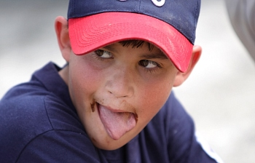
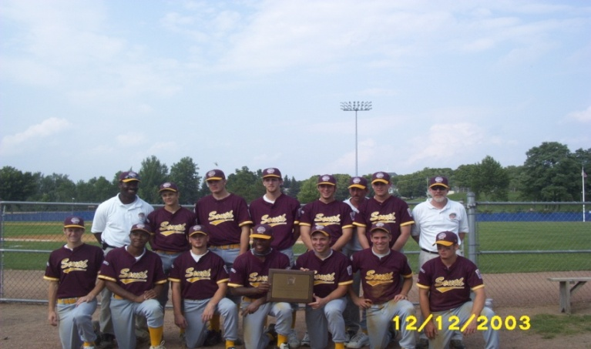
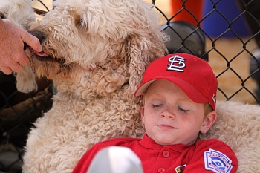
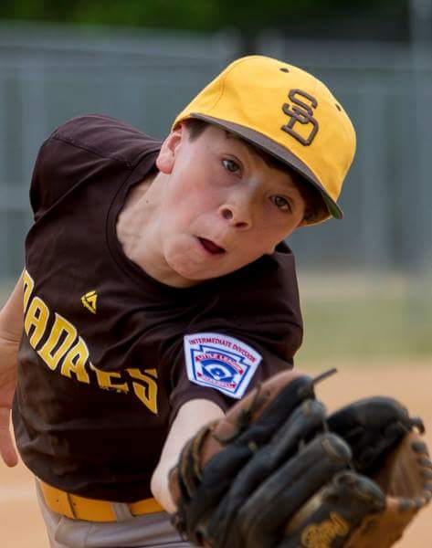
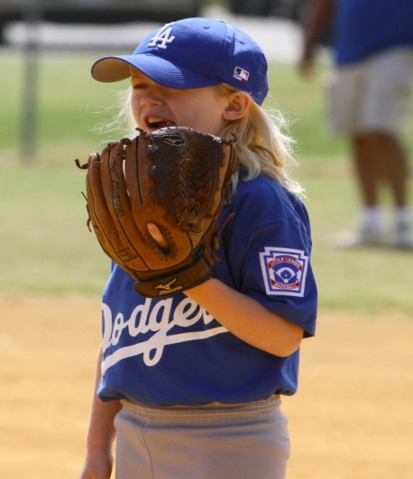
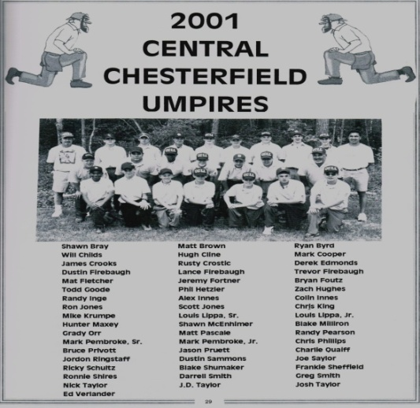
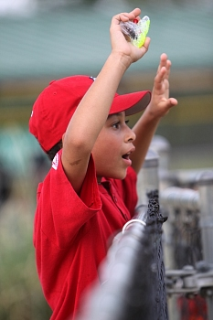
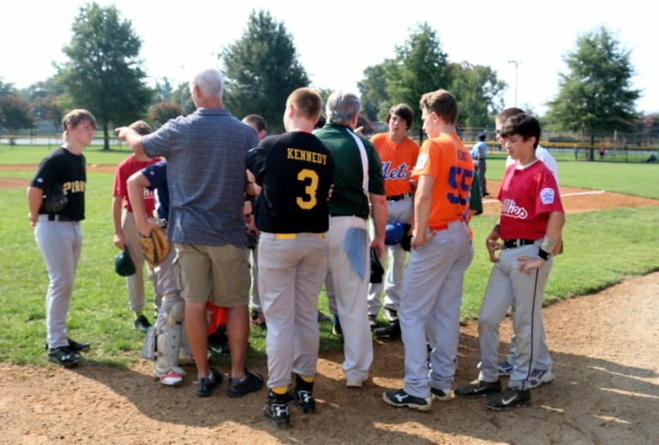

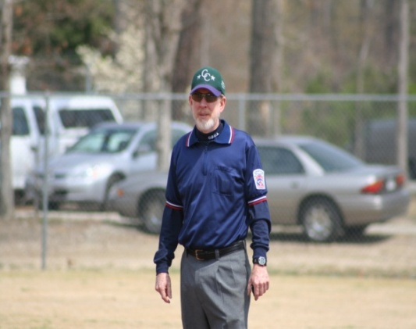
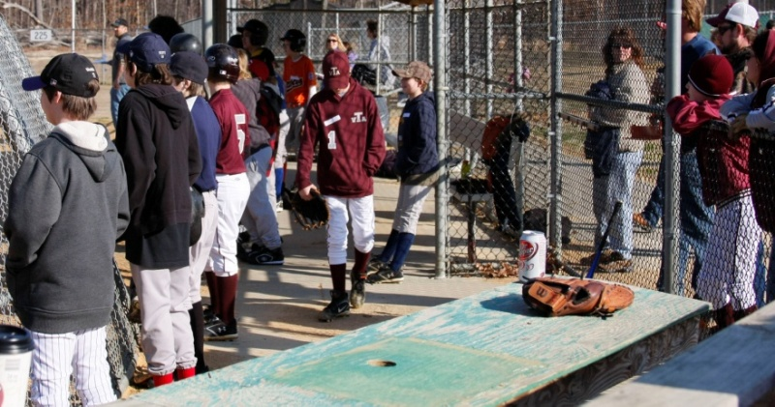
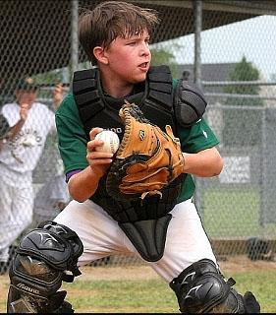
Welcome to the 2025
CCLL Managers Meeting
Notes:
President

Slide 2
Welcome and Thank You
Welcome to CCLL!
Thank you for Managing with Us
Remember YOU are the FACE of CCLL
Most Parents will NEVER meet the Board
If You are SUCCESSFUL We are SUCCESSFUL
Notes:
President

Slide 3
Meet your CCLL Board
How Can We Help You Be Successful?
Support Staff:
President – Jason Moore
VP Baseball & Coaching Coordinator – Bob Zane
VP Operations & UIC – Matt Thore
Secretary- Allyson Waddell
Player Agent – Paul Scofield
Treasurer – Cheryl Norton
Uniform Manager – Tracie Henry-Neill
Notes:
President

Slide 4
Meet your CCLL Board
League Information Officer - Chris Lasher
Sponsorships Fundraising Manager – Joe Mayes
Marketing PR Manager – Chris Lasher
Safety Officer – Ryan Stech
Concession Manager – Lovena Thore
Grounds & Maintenance Manager – Tony Cimino
Equipment Manager – Justin Harmon
Scheduling Manager – Joshua Aiken
Event Manager – Jonathan Spain
Notes:
President

Slide 5
Meet your CCLL Board
League directors
  Buddy Ball (4) - Vacant
  Rookie (5-6) - Jonathan Spain
  Coach Pitch (7-8) - Ashley Goulder
  Minor (9-10) - Joe Mayes
  Major (11-12) - Scott Montoya
  Intermediate (50/70) (13) - Vacant
  Senior (14-16) - Eric Swann
Notes:
President

Slide 6
League Philosophy
CCLL strives to instill the virtues of good character in our players:
Sportsmanship
Honesty
Loyalty
Courage
Respect for Authority
So that they may be well adjusted, stronger and happier children and will grow to be decent, healthy and trustworthy citizens.
How will the Kids learn these Values??
Notes:
VP Player Relations

Slide 7
League Philosophy
This is LITTLE LEAGUE
Teach the Kids to LOVE Baseball!
MUST Play - Players can’t sit 2 consecutive innings
Bat the Line-Up - Free Substitutions
PLEASE Move Players Around - Don’t be that coach that didn’t rotate all season
MODEL the Behavior You Want from Your Players
Manager Evaluations are provided each season by your team
The season should be fun and positive for ALL
Notes:
VP Player Relations

Slide 8
Disciplinary Policy
YOU are the key person
YOU Are Responsible For the conduct of Your:
  Players, Coaches, Parents & Spectators
Kids are going to do what WE do:
  Get parents on board EARLY
  Set Ground Rules & Expectations
SHOW your players/parents how to “Honor the Game”
Do NOT leave the field w/o notifying the umpire
No Smoking / Vaping / Dip on or off the field at the park
Notes:
Coaching Coordinator

Slide 9
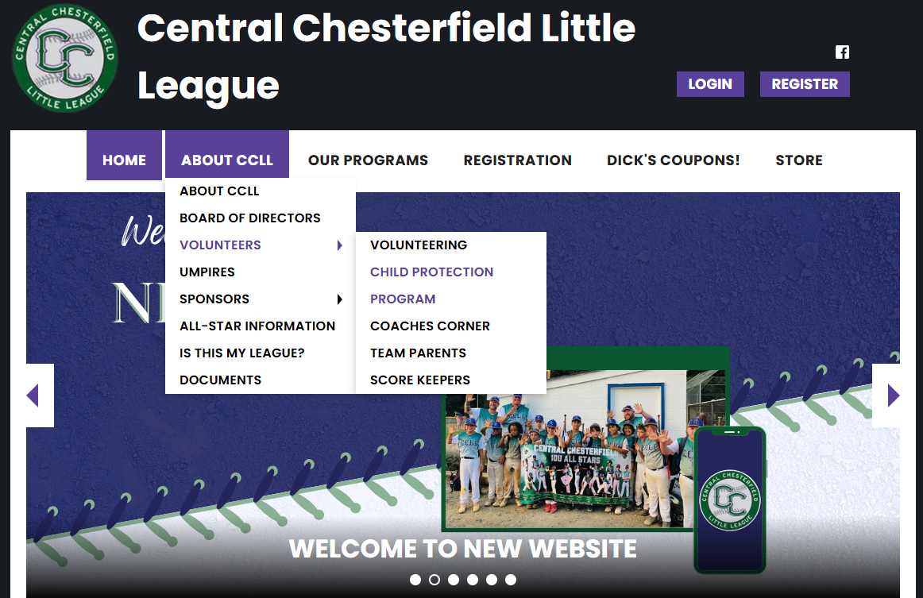
Making YOU Successful!
Please use the resources on the website!
Notes:
Coaching Coordinator

Slide 10
Communication
This is mostly everyone's first year using this system
League wide communications
  Statusfy – web or app stores *set alerts/favorite your fields
  Chesterfield County Parks & Rec
Team Central
  Fully communicate with teams from our website i.e practice schedules, send email, texts
GAMECHANGER INTEGRATION
We recommend not using the Import option as sync/scheduling issues have been reported

Slide 11
Background Checks
Little League International (LLI) Requirements:
LLI requires a yearly Background Check on all managers, coaches, Board of Directors, and any other persons, volunteers or hired workers, who will provide regular service to the league/or have repetitive access to, or contact with players or teams
Volunteers will receive an email from JDP via CCLL once the volunteer form is processed
Notes:
Coaching Coordinator

Slide 12
Background Checks
Chesterfield County Requirements:
The county requires a parks and recreation background check coaches card for all managers, assistant coaches and Board of Directors of each league. This card expires every three years and must be current to have regular access to players.
  https://www.chesterfield.gov/821/Recreational-Sports

Slide 13
Training
Little League International (LLI) Requirements
LLI requires all volunteers to complete yearly Abuse Awareness Training
  https://www.littleleague.org/university/articles/abuse-awareness-training-course/
LLI requires Managers and Coaches to complete yearly Concussion Training
  https://nfhslearn.com/courses/concussion-in-sports-2
Notes:
Coaching Coordinator

Slide 14
Important Dates
February 22 | Player Assessments
February 24 | Senior, Intermediate, Major Player Draft
February 25 | Minor, Coach Pitch, Rookie/Buddy Ball Draft
March 1 | Practice Begins
March 2 | Manager/Coaches Clinic
March 21 | Field Manager Meeting
March 22 | Opening Day
May 5 | Playoffs Begin
May 17 | Championship Day
All dates are posted on the CCLL website Calendar.
Notes:
Coaching Coordinator

Slide 15
Player Assessments
All Managers from Coach Pitch through Senior must participate in Player Assessments
Please plan to stay for the duration of your levels assessment
Useful supplies to bring:
  Clipboard
  Rating Sheets (will be provided at arrival)
  Spare pens/pencils
  Chair
  Drinks/Snacks
Buddy Ball and Rookie Managers: we need your help at Player Assessments!
Notes:
Coaching Coordinator

Slide 16
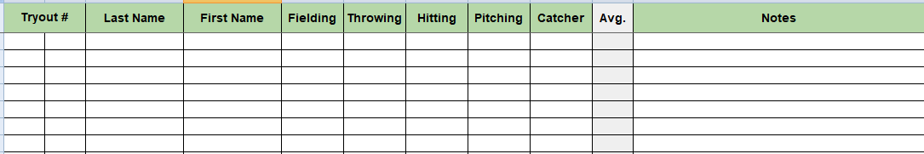
Player Assessments
You will assess players at your assigned cage
You will receive a print out of all players registered at your level
Players will be called out using their tryout number and last name
  The tryout number is made up of the League Age followed by a number. For example, 8-4 would indicate a player that is league age 8 and 4th on the list
Add write-in players or players attempting to play up a division as they may not be on your sheets
At the end of the assessments, confer with your fellow managers to ensure all players are accounted for
Notes:
Coaching Coordinator

Slide 17
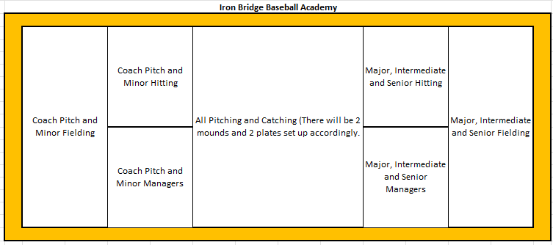
Player Assessments
Assessment Times (All Levels): Sat 2/22, 10:00am - 5:00pm
Players will:
Check in at Iron Bridge Sports Park to get their try out number
Players will be fitted for their uniform
Players will be sent to Iron Bridge Baseball Academy for Assessment

Slide 18
Player Draft
All Managers from Coach Pitch through Senior must participate in the Player Draft
Draft rules are posted on the website “Under Documents” and will be sent to each manager prior to the draft
Draft Dates / Times:
  Senior: 2/24, 5:30 - 6:30
  Intermediate: 2/24, 6:30 - 7:30
  Major: 2/24, 7:30 - 8:30
  Minor: 2/25, 5:30 - 6:30
  Coach Pitch: 2/25, 6:30 - 7:30
  Buddy Ball and Rookie: 2/25, 7:30
Notes:
Coaching Coordinator

Slide 19
Opening Day
Opening Day is March 22nd
Player Parade
Players and coaches only!
Staging area on Field 4 by 8:45am
Opening Day Ceremony
Starts at 9:00 on field 3 – expected to last around 40 minutes
Sponsor meet and greet tables
Get to know our sponsors throughout the day
Play Ball
Most importantly games start on all fields by 11:00 so time to watch the kids play ball!

Slide 20
Pictures
New this year: Pictures will be held inside!
Pictures will be taken by TSS Photography
Go to Iron Bridge Sports Park (room is to the right) any of the available times below
Times:
  Sun 3/23 1:00pm - 6:00pm
  Mon 3/24 6:00pm - 8:00pm
  Tue 3/25 6:00pm - 8:00pm
Picture purchases benefit CCLL!
Regular Season Banners can be purchased at the teams expense

Slide 21
Uniforms
Players will be fitted for uniforms on the following dates:
February 22 10:00 am-5:00 pm at Ironbridge Sports Park Building (IBSP) during Player Assessments
February 26 6:00-8:00 pm Ironbridge Sports Park Building (IBSP)
March 1 10:00 am-12:00 pm Harry G Daniels field's containers (behind field 2) This will be the final fitting!

Slide 22
Uniforms
Managers must submit Player Information spreadsheet by Feb 28.
This will be confirmation (via phone) for name (jersey and hat), size, and number. Sizing is conducted by the Uniform Committee.
Hat Embroidery for all levels and LL Patches (excluding Buddy Ball) sewn on prior to Uniform Distribution (Included in registration fee)
Add you and your Assistant Coaches Jersey’s (full names and sizes) to your Player Information Spreadsheet at the bottom, and they will be packaged with team jersey pick-up ($25 each due at pick-up – Manager Jersey included if you meet all preseason requirements)
Little League Patches (Left Sleeve)
Lou Can Press Them On - $28/team
Deliver to Lou @ 8717 Privet Drive
Hat Embroidery - Many Resources Around
Additional Hats & Jerseys Available – April 5th after Manager Meeting and Opening Day
Notes:
Uniform Manager

Slide 23
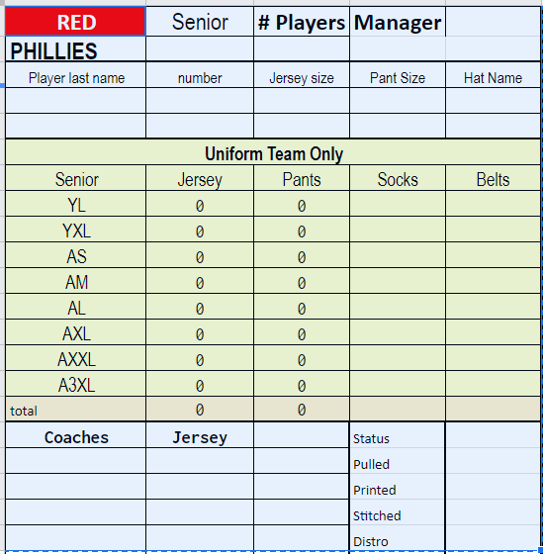
Uniforms - Player Information
Due to Uniforms by Feb 28 – Don’t Be Late!
Validate spelling of last name
No duplicate numbers
Jersey Size: Use code from “Uniform Team Only” box no substitutes – Notify Uniforms if size not listed in box for submission
Pant Size: Grey out all players that have “NO” on player list below – Do Not put Size
Pant Size: Use code from “Uniform Team Only” box no substitutes – Notify Uniforms if size not listed in box for submission
Hat Stitching: First name, last name, or appropriate nickname
1
2
3
4/5
6
Do Not Enter Any Information In “UNIFORM TEAM ONLY” Box
Enter Full Name and Size for
Manager and Asst Coaches
Player Information built from Uniform Fitting Lists and Initial Phone Call by Managers
Make Sure Names Spelled Correctly
& follow directions on email

Slide 24
Scheduling
Managers will be called the weekend of assessments to schedule pre-season practices. Practices will start 3/1. If You do not answer I will move to the next team on the list.
Each team has the opportunity to schedule practices during the regular season and should schedule 1-2 practices per week.
Practice requests must be emailed to scheduling@ccllbaseball.com – Emails must include team name, division, requested dates, preferred fields and a GOOD CONTACT NUMBER. If the email does not have this information, it will be disregarded.
  Little League Patches (Left Sleeve)
    Lou Can Press Them On - $28/team
  Deliver to Lou @ 8717 Privet Drive
  Hat Embroidery - Many Resources Around
  Additional Hats & Jerseys Available – April 5th after Manager Meeting and Opening Day
Notes:
Uniform Manager

Slide 25
Scheduling
All practice requests must be submitted by Tuesday the week before start of scheduled dates for us to meet the county requirements.
Lights are the responsibility of the county any issues call the County Rover at 804-748-1624.
Any scheduling issues/discrepancies/clarifications contact Joshua at 804-363-9407 by text message. Game schedule should be completed by TBD
Currently no games will be scheduled Spring Break. Practice times will be available.

Slide 26
Equipment
If you did not turn in equipment from last year, you will only be issued baseballs for this season. If your equipment was lost or stolen, please contact by email to discuss. equipment@ccllbaseball.com
Team Equipment Pick Up Dates:
  Friday- Feb 21st-5:00PM-7:00PM
  Friday- Feb 28th-5:00PM-7:00PM
**Please Note – These are the only pick up dates. If you are not available, please have your assistant coach or team parent meet. I will not be doing additional days unless it is a true emergency!
  Little League Patches (Left Sleeve)
    Lou Can Press Them On - $28/team
  Deliver to Lou @ 8717 Privet Drive
  Hat Embroidery - Many Resources Around
  Additional Hats & Jerseys Available – April 5th after Manager Meeting and Opening Day
Notes:
Uniform Manager

Slide 27
Field Maintenance
Pre season field prep days will from 11:00AM to 3:00PM on:
  Saturday March 1st and Saturday March 8th
  All teams are expected to provide at least one participant to help get things ready on one of the two day scheduled.
  Contact Tony at 804-731-0562 to sign up
Final field prep & manager meeting will be 6:00pm to 8:00PM on Friday March 21st all managers must be present.
Due to extensive changes within the county this year, we don't have a clear site on all of our weekly responsibilities yet. After our meeting with the county a communication will be put out to advise of league
  Saturday Mornings: The league is responsible to line the fields.
  Weeknights: League is responsible for dragging the fields and working the pitchers mounds & Batters Boxes.
County will update field closings for week night play at 4:00PM call 804-748-1001. Weekend closings will be the leagues responsibility. Notification will be by email and or Meta.
Notes:
VP Operations

Slide 28
Safety
First Aid Kits – Make sure it is always with you
Accident Reports – Forms are in the Concession Stand and online
Pre-game warm-ups, throwing, should be performed within the designated warm up areas. Fielding warm ups shall be performed within the boundaries of the field.
Head First Slides are not permitted Majors and below Except when runner is returning to a base.
The catcher must wear catcher's helmet and mask with a throat guard in warming up pitchers. This applies between innings and in the bullpen during a game and also during practices.
Managers and Coaches may warm up pitchers before or during a game. (Rule 3.09)
Adult supervision is required at all times when the batting cage is in use. The only one to hold a bat will be the batter in the cage. The batter must wear a helmet at all times when in the cage.
Notes:
Safety Officer

Slide 29
All-Stars
District All-Stars – Ages 7 and Up
  7-8 Coach Pitch Tournament June 15th – July 1st Location TBD
  8/9/10 Baseball June 15th – July 1st Location TBD
  9/10/11 Baseball June 15th – July 1st Location TBD
  LL (Majors) Baseball June 15th – July 1st Location TBD
  Intermediate Baseball June 15th – July 1st Location TBD
  Junior Baseball June 15th – July 1st Location TBD
  Senior Baseball June 15th – July 1st Location TBD
Invitational All-Stars
  Ages 7 and Up (Coach Pitch through Major)
  One local tournament in Richmond Area (Dates and Locations TBD)
All-Star Tryouts
  May 16th Ironbridge Baseball Academy
Notes:
Coaching Coordinator

Slide 30


Know the Rules
Be sure to read both the official Little League Rule Book and our CCLL Local League Rules!
You can get the free little rule book at the Apple App Store or on Google Play Store.
Notes:
Coaching Coordinator

Slide 31
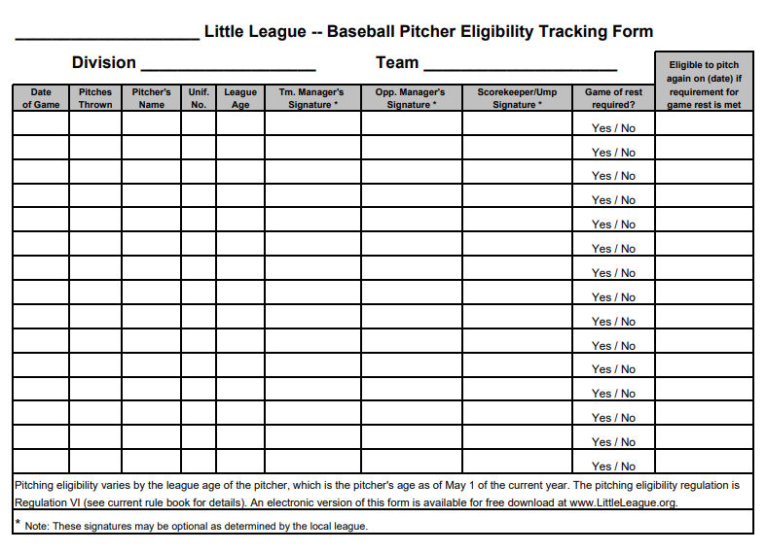
Know the Rules
Pitch Tracking
You must follow Little League Pitch Tracking rules as described in Regulation VI – Pitchers in the rulebook.
You must keep the Little League Baseball Pitcher Eligibility Tracking Form with you and complete it after each game.
If you have a travel ball player, work with the parents on including their travel ball pitching into your Little League Pitch Tracking!
Notes:
Coaching Coordinator

Slide 32
Umpires
Plate meeting prior to game is mandatory – Team
representative at this meeting will be considered the Manager
for the game. Expect the following:
                Introductions
                Are Players probably equipped (bats/helmets/safety gear etc)
              County card verification
              Line-up Exchange
              Game Points of Emphasis
              Code of Conduct – Zero tolerance for bad language
              Ground Rules
              Start time
Notes:
Umpire In Chief

Slide 33
Umpires
  All umpires go through many hours of training
(Both new and experienced)
  Umpires receive continuous training, development and coaching (throughout the season)
  Please be respectful of our umpires
  Judgment calls are final (Rule 9.02)
  Only rule misinterpretations can be protested (Rule 7.04)
  Umpires are responsible for all game management on the field.
  Umpires can only discipline/eject team members or individuals authorized to be on the field of play. Their Authority does not extend outside of playing area. However, umpires can request the on duty board member have a spectator removed from the park.
Notes:
Umpire in Chief

Slide 34
Umpires
Please Note!
The entire baseball community is suffering from a HUGE umpire shortage – and this includes CCLL
Due to this, the CCLL staff is significantly reduced and may lead to situations where there will be only one umpire on a game. Team managers or coaching staff may need to be utilized in certain situations
Notes:
Umpire In Chief

Slide 35
Umpires
Unlike most LL programs, we have our own umpire training program and use our own “in house” umpires!
If by chance you or anyone know of any individuals 13 years’ old or older, interested in learning a new skill that will contribute to the local community and give back to the kids of Chesterfield send the our way. We will train and prepare them to umpire in any youth baseball game. Please email us at umpires@ccllbaseball.com.
  SHOW your players how to “Honor the Game”
Umpires are a huge part of a successful season and we are looking forward to a great 2024 Spring Baseball Season!
Umpire Mentoring – Your feedback is critical
  Please complete evaluations after games and email them to umpires@ccllbaseball.com
Notes:
Umpire In Chief

Slide 36
Closing Announcements
THANK YOU
For Volunteering to Manage a Team
with CCLL!
Lets Play Ball!
Notes:
President

